Slide 1
Linear Regression, Perceptrons, Logistic Regression, and all that
CSE 253
Neural Networks Lecture 3

Slide 2
Overview
In this lecture, if time, we will cover:
Linear regression (not really, very short)
The Perceptron
Logistic Regression
Multinomial Regression

Slide 3
Last time
We talked about the four kinds of learning studied in machine learning:
Unsupervised (learn a model of the data)
Supervised (learn a mapping from input to a target)
Reinforcement (learn from your mistakes)
Imitation learning (not usually covered in textbooks...)

Slide 4
Last time
Supervised learning (learn a mapping from input to a target) comes in two forms:
Classification (learn a mapping to a category label)
Regression (learn a real-valued function)
This is the textbook story, but in fact, it is hard to categorize all supervised learning into just these two – for example, transforming English sentences to French ones.

Slide 5
Linear regression
An example of supervised learning
There is a set of inputs and associated outputs
We assume there is an underlying line that has been corrupted by noise.
(go to board)
And it is a neural network!
Notes:
Wx=t
X=W^-1t

Slide 6
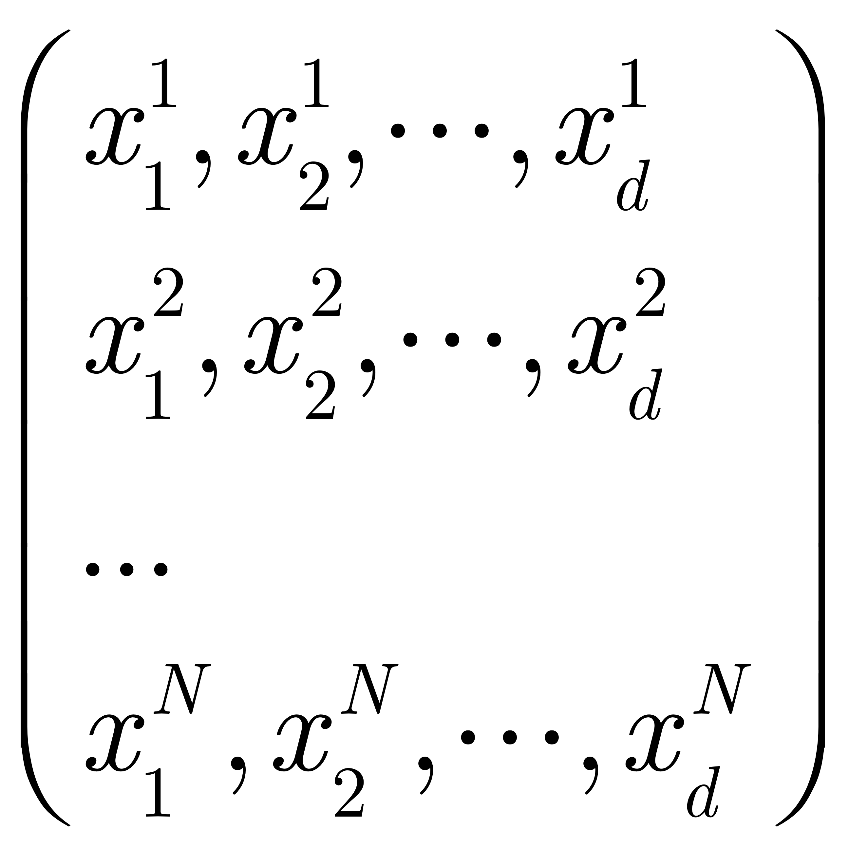
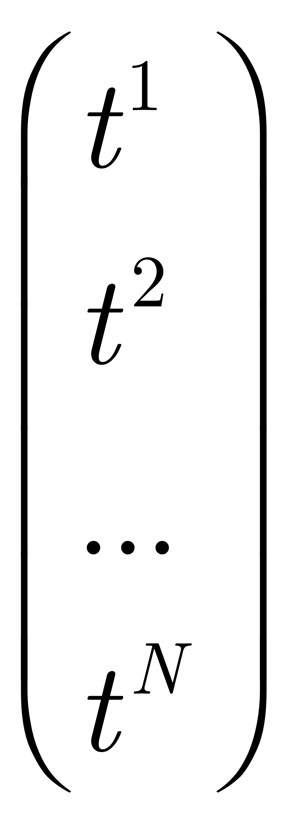
Linear regression
Given:
A set of inputs: and a set of targets:
(the design matrix)
Find a set of coefficients (weights) that linearly combine the inputs to get as close to the targets as possible.
Notes:
Wx=t
X=W^-1t

Slide 7
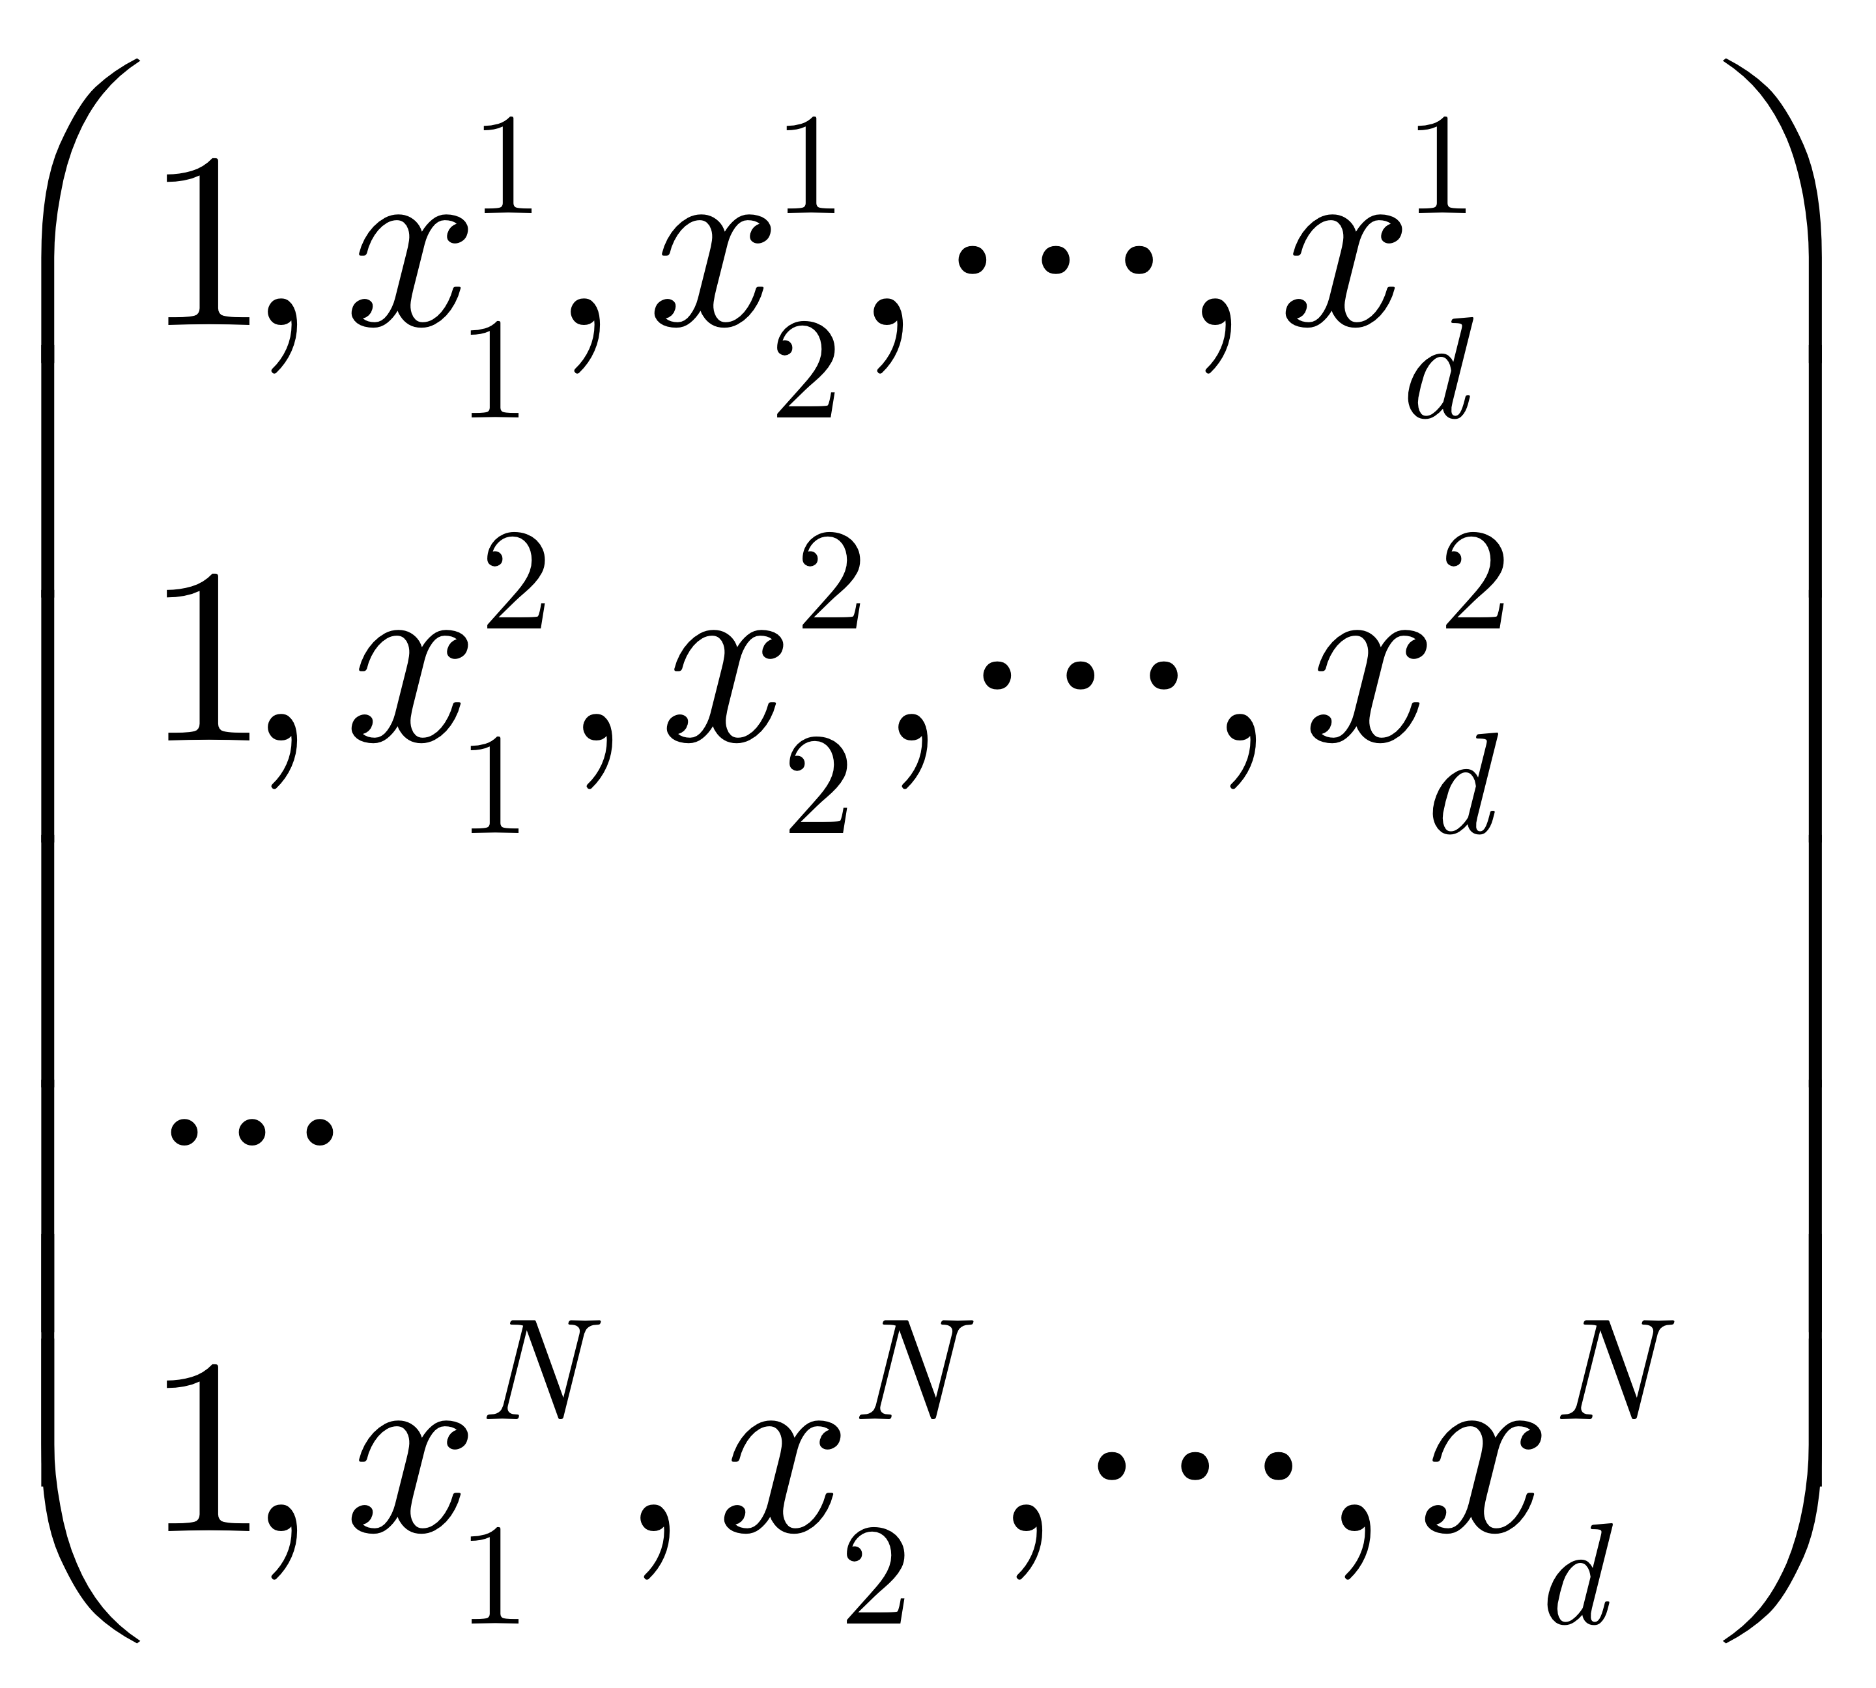
Linear regression
First, to make things a bit simpler, we tack on a column of ones:
Notes:
Wx=t
X=W^-1t

Slide 8


Linear regression
The goal:
Where “ ” means “as close to as possible”
Notes:
Wx=t
X=W^-1t

Slide 9
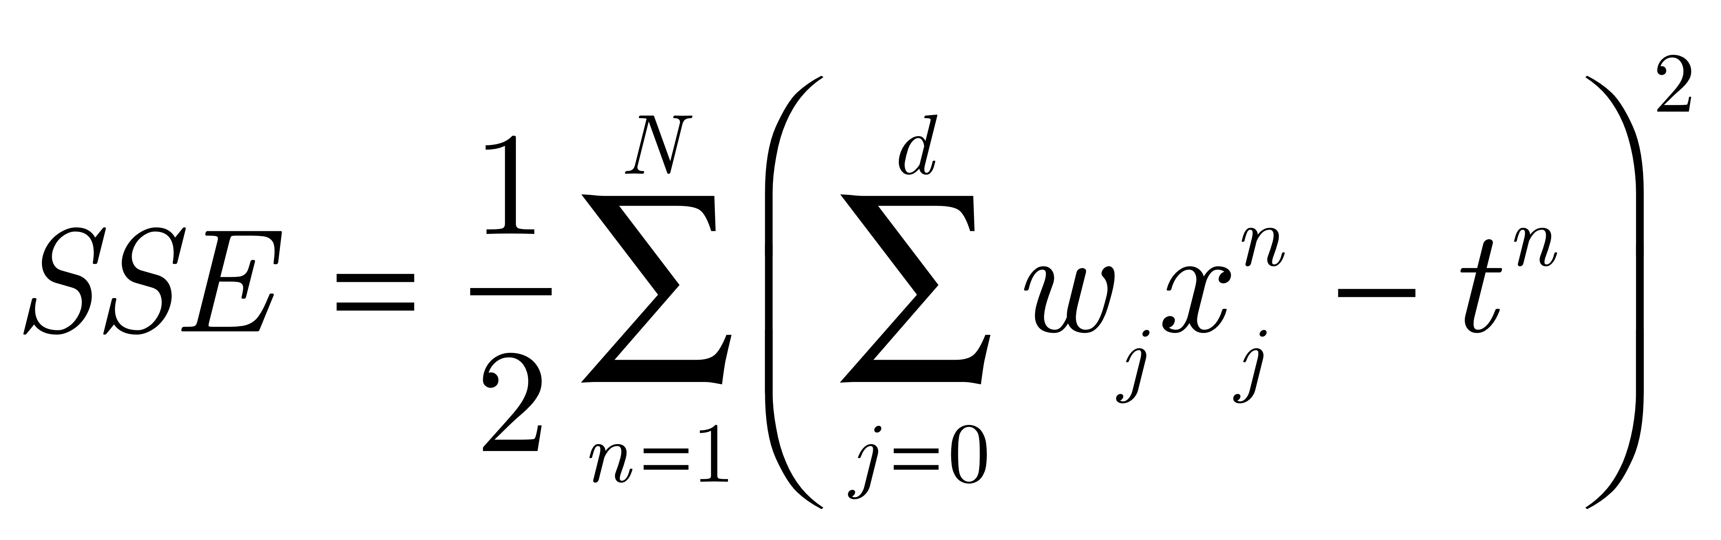
Linear regression
The goal:
“Close” means the w that minimizes the Sum Squared Error (SSE)
Notes:
Wx=t
X=W^-1t

Slide 10
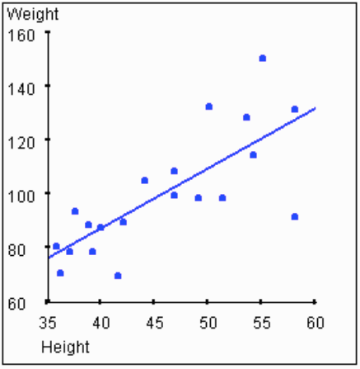
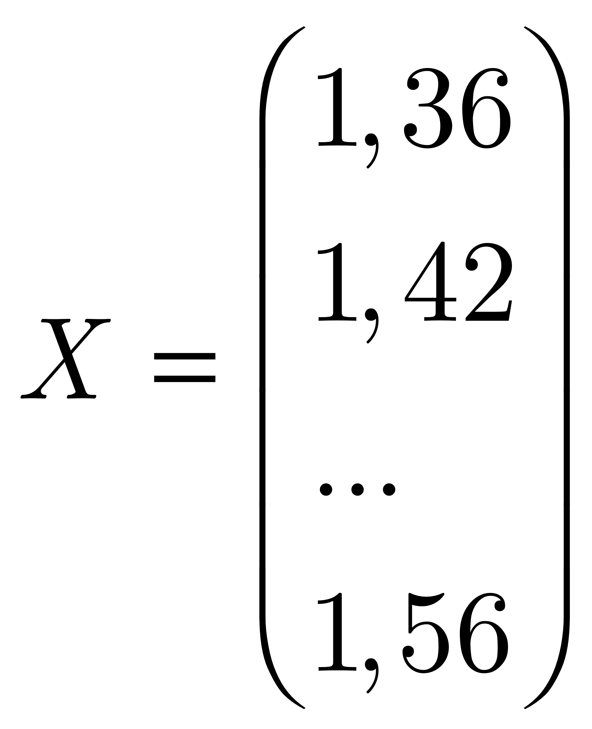
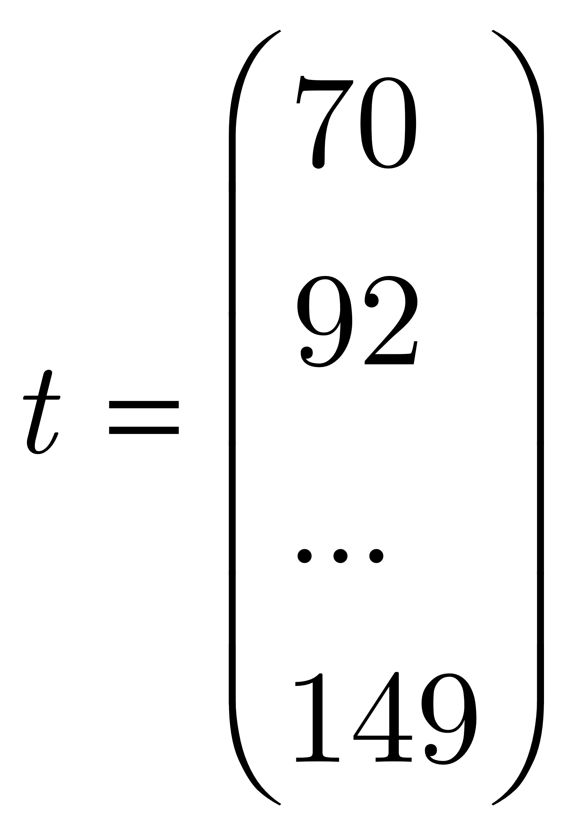
Linear regression example: Height vs. Weight
Notes:
Wx=t
X=W^-1t

Slide 11
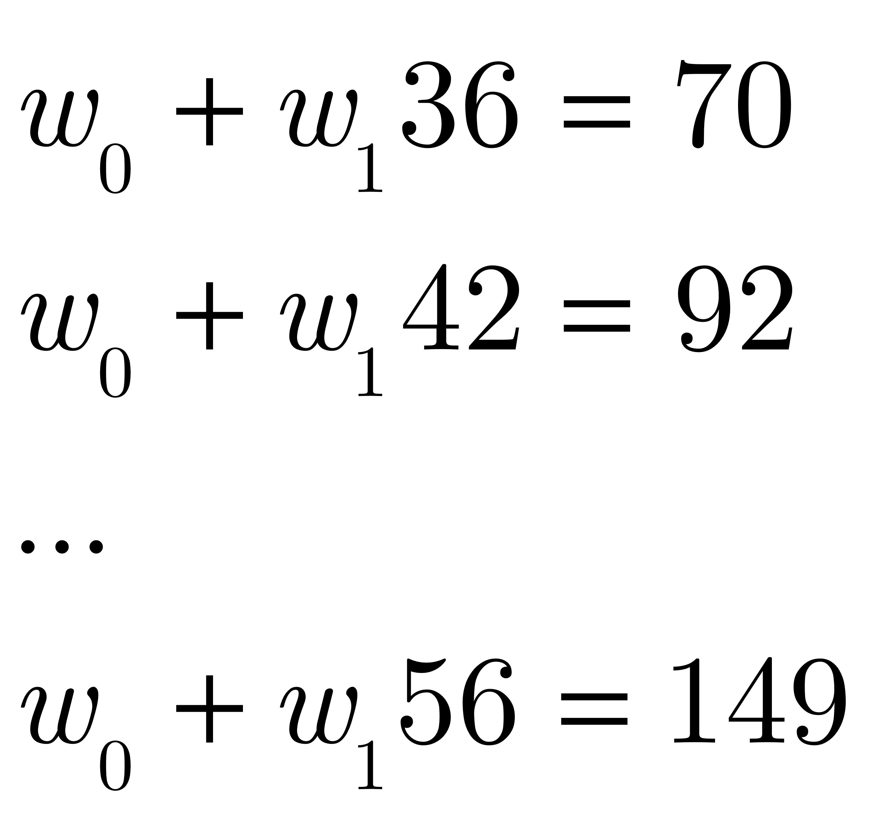
Linear regression example: Height vs. Weight
Solving this corresponds to finding w₀ and w₁ – we have 20 equations in two unknowns.
Notes:
Wx=t
X=W^-1t

Slide 12
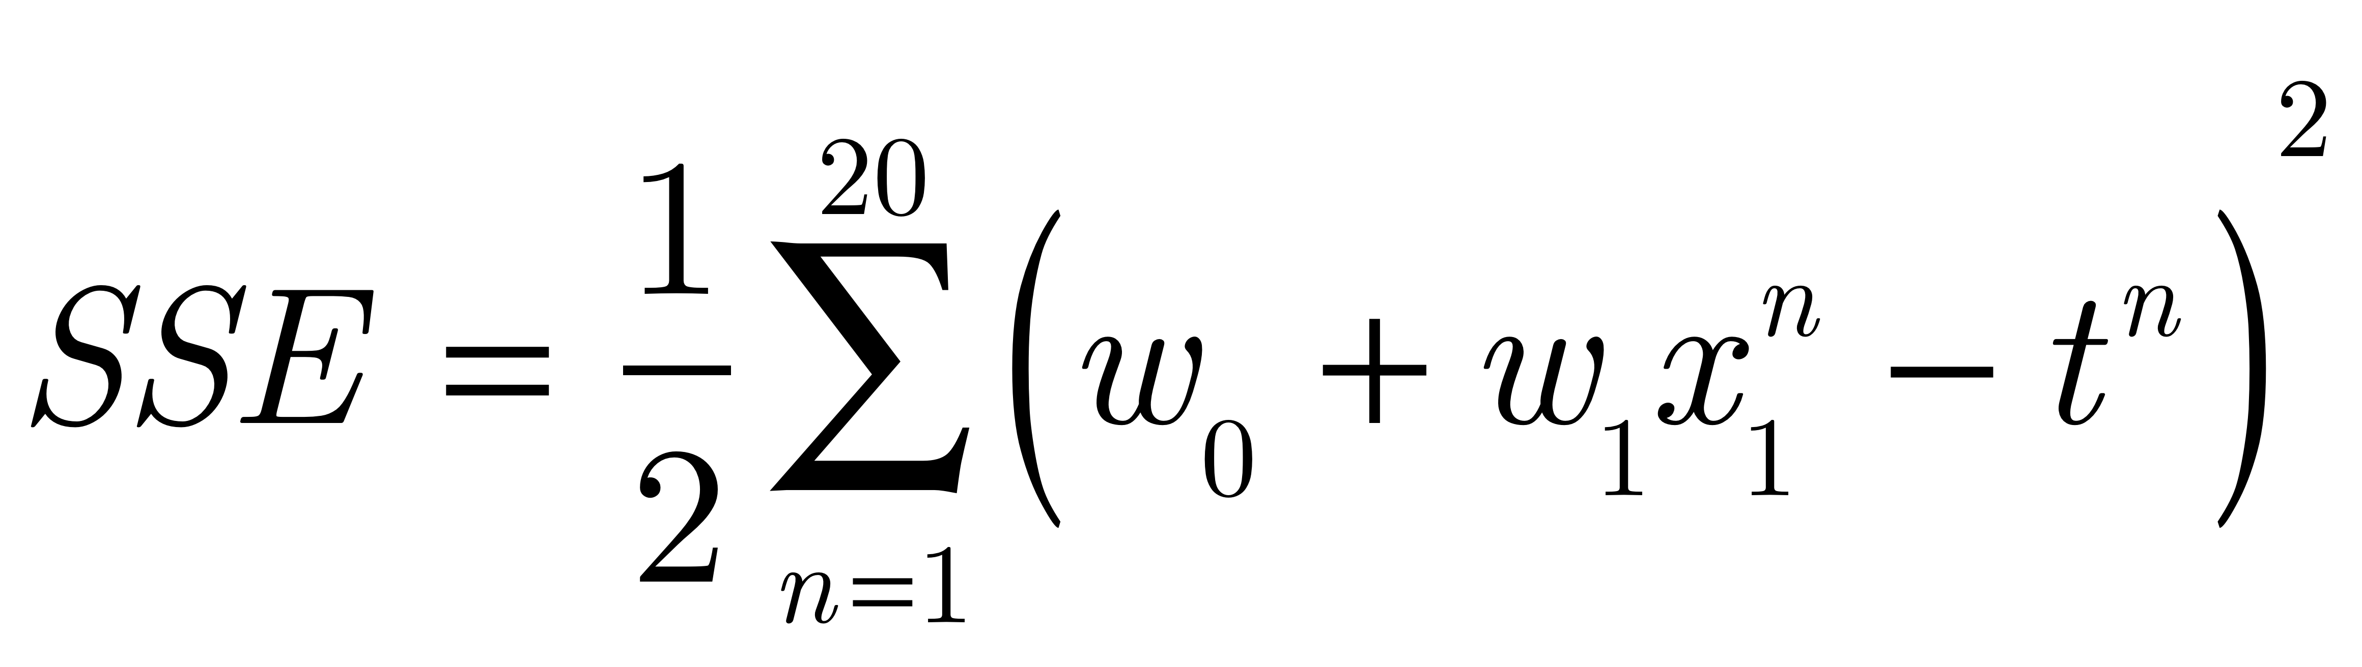
Linear regression example: Height vs. Weight
Taking the derivative of the SSE with respect to w and setting it equal to 0:
Notes:
Wx=t
X=W^-1t

Slide 13
Solving for w
Taking the derivative of the SSE with respect to w and setting it equal to 0:
...etc.

Slide 14
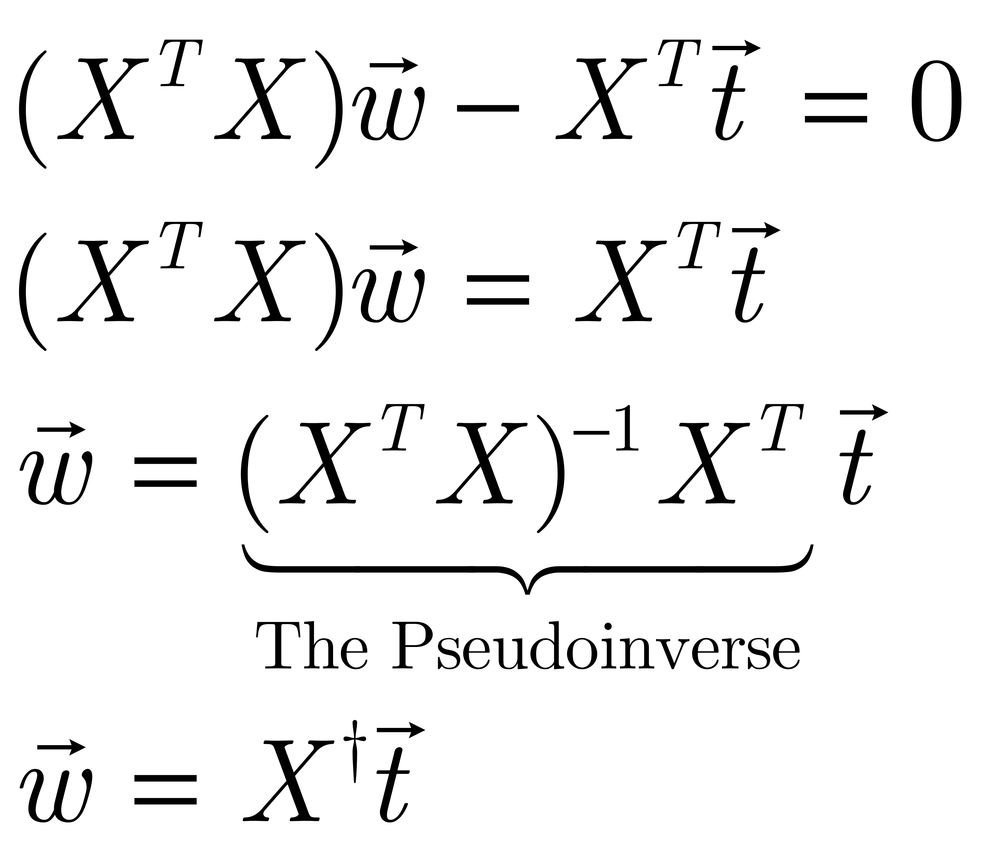

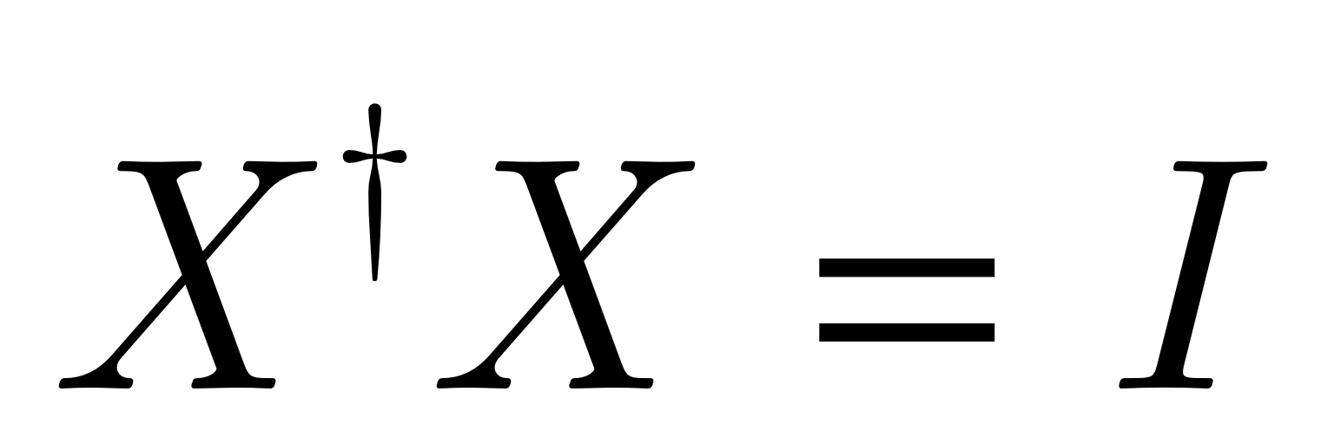
Solving it in matrix form:
is called the pseudoinverse of X
If X is square, then
Much simpler!
Notes:
Wx=t
X=W^-1t

Slide 15
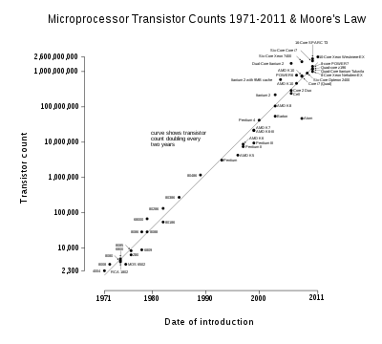
Note: Not all regression is Linear!Nonlinear regression (by transforming a variable – here, using the log
Notes:
Wx=t
X=W^-1t

Slide 16
Note: Not all regression is Linear!Nonlinear regression
Or by expanding the inputs by assuming some underlying functional form (e.g., a polynomial)
We try to find coefficients of the polynomial that fit the data (a.k.a. polynomial curve fitting)
Or, by using a neural network to fit the data...
Notes:
Wx=t
X=W^-1t

Slide 17
Linear Regression Summary
In regression problems, we are trying to fit a continuous function
Linear regression is fitting a line
It can be solved by inverting a matrix
Some problems might be better solved by gradient descent in the SSE – when the design matrix is too large
Not all regression is linear!

Slide 18
Overview
In this lecture, if time, we will cover:
Linear regression (not really, very short)
The Perceptron
Logistic Regression
Multinomial Regression

Slide 19
Perceptrons
The first trainable, linear classifier
We start with a bit of history
Consider what they can represent
Give an intuitive version of the learning rule
Give the computer science version of the learning rule

Slide 20

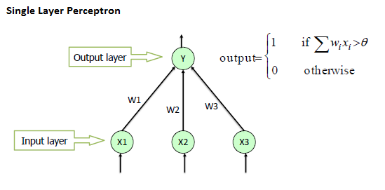
Perceptrons: A bit of history
Frank Rosenblatt studied a simple version of a neural net called a perceptron:
A single layer of processing
Binary output
Can compute simple things like (some) boolean functions (OR, AND, etc.)

Slide 21
Perceptrons: A bit of history
Computes the weighted sum of its inputs (the net input, compares it to a threshold, and “fires” if the net is greater than or equal than the threshold.
(Note in the picture it’s “>”, but we will use “>=“ to make sure you’re awake!)

Slide 22
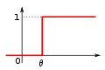
The Perceptron Activation Rule
output
net input
This is called a binary threshold unit

Slide 23
Clicker Question FREQUENCY: DD
The input to a model neuron that we have discussed can be written as (where w and x are the weight vector and input vector, respectively)
xw
x+ w
x^{T}w
w^{T}x
Either c or d

Slide 24
Clicker Question
The input to a model neuron that we have discussed can be written as (where w and x are the weight vector and input vector, respectively)
xw
x+ w
x^{T}w
w^{T}x
Either c or d

Slide 25
Quiz
X1 | X2 | X1 OR X2
0 | 0 | 0
0 | 1 | 1
1 | 0 | 1
1 | 1 | 1
Assume:
FALSE == 0, TRUE==1, so if X1 is false, it is 0.
Can you come up with a set of weights and a threshold so that a two-input perceptron computes OR?

Slide 26
Quiz
X1 | X2 | X1 AND X2
0 | 0 | 0
0 | 1 | 0
1 | 0 | 0
1 | 1 | 1
Assume:
FALSE == 0, TRUE==1
Can you come up with a set of weights and a threshold so that a two-input perceptron computes AND?

Slide 27
Quiz
X1 | X2 | X1 XOR X2
0 | 0 | 0
0 | 1 | 1
1 | 0 | 1
1 | 1 | 0
Assume:
FALSE == 0, TRUE==1
Can you come up with a set of weights and a threshold so that a two-input perceptron computes XOR?

Slide 28
Perceptrons
The goal was to make a neurally-inspired machine that could categorize inputs – and learn to do this from examples

Slide 29
Learning: A bit of history
Rosenblatt (1962) discovered a learning rule for perceptrons called the perceptron convergence procedure.
Guaranteed to learn anything computable (by a two-layer perceptron)
Unfortunately, not everything was computable (Minsky & Papert, 1969)

Slide 30
Perceptron Learning
It is supervised learning:
There is a set of input patterns (called the design matrix)
and a set of desired outputs (the targets or teaching signal)
The network is presented with the inputs, and FOOMP, it computes the output, and the output is compared to the target.
If they don’t match, it changes the weights and threshold so it will get closer to producing the target next time.

Slide 31
Perceptron Learning
First, get a training set - let’s choose OR
Four “patterns”:
INPUT TARGET
0 0 0
0 1 1
1 0 1
1 1 1
This is the design matrix (you don’t need to know that, but it makes you sound smarter at conferences…)
output
net input

Slide 32
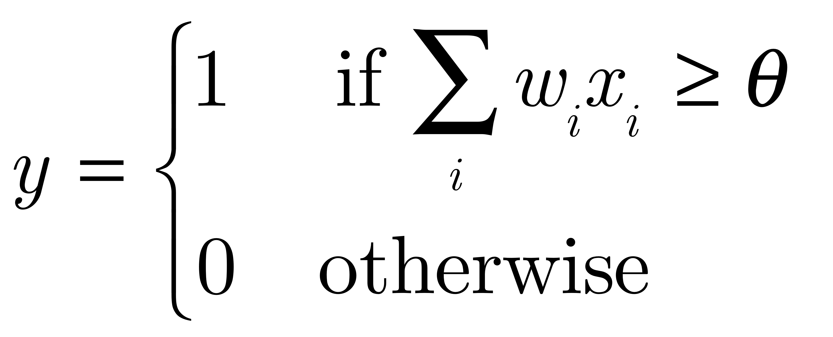
Perceptron Learning Made Simple
Output activation rule:
First, compute the output of the network:
Learning rule:
If y is 1 and should be 0, then lower weights to active inputs and raise θ
If y is 0 and should be 1, then raise weights to active inputs and lower θ
(“active input” means x_{i} = 1, not 0)

Slide 33
Perceptron Learning
First, get a training set - let’s choose OR
Four “patterns”:
INPUT TARGET
0 0 0
0 1 1
1 0 1
1 1 1
Now, randomly present these to the network, apply the learning rule, and continue until it doesn’t make any mistakes.
output
net input

Slide 34
STOP HERE FOR DEMO (on board)

Slide 35
Characteristics of perceptron learning
Supervised learning: Gave it a set of input-output examples for it to model the function (a teaching signal)
Error correction learning: only corrected it when it is wrong (never praised! ;-))
Random presentation of patterns.
Slow! Learning on some patterns ruins learning on others.

Slide 36


Perceptron Learning Made Simple for Computer Science
Output activation rule:
First, compute the output of the network:
Learning rule (note it is even simpler with a bias!)
If output is 1 and should be 0, then lower weights to active inputs and the bias w₀
If output is 0 and should be 1, then raise weights to active inputs and the bias w₀
(“active input” means x_{i} = 1, not 0)

Slide 37
Perceptron Learning Made Simple for Computer Science
Output activation rule:
Learning rule:
w_{i} = w_{i} + α*(teacher - output)*x_{i}
(α is the learning rate)
This is known as the delta rule because learning is based on the delta (difference) between what you did and what you should have done: δ = (teacher – output)
N.B. In what follows, to make things simple, I will leave out α by assuming it is 1.

Slide 38
Are these the same rule?
Learning rule:
If output is 1 and should be 0, then lower weights to active inputs and the bias
If output is 0 and should be 1, then raise weights to active inputs and the bias
Learning rule: (remember I am assuming α=1, so leaving it out)
w_{i} = w_{i} + (teacher - output)*x_{i}
w_{i} = w_{i} + δx_{i}
(δ = (teacher-output))

Slide 39
Let’s convince ourselves these are the same…
Learning rule:
If output is 1 and should be 0, then lower weights to active inputs and the bias
w_{i} = w_{i} + (teacher – output)x_{i}
w_{i} = w_{i} + (0 – 1)1 (“x_{i} is an active input” means x_{i} = 1)
= w_{i} – 1 lower weight
What if x_{i} is inactive?
w_{i} = w_{i} + (teacher – output)x_{i}
w_{i} = w_{i} + (teacher – output)0
= w_{i} (no change)

Slide 40
Let’s convince ourselves these are the same…
Learning rule:
If output is 0 and should be 1, then raise weights to active inputs and lower the threshold
w_{i} = w_{i} + (teacher – output)x_{i}
w_{i} = w_{i} + (1 – 0)1
= w_{i} + 1 (raise weight)

Slide 41
Let’s convince ourselves these are the same…
What about the bias? Recall w₀ = -θ
We just treat w₀ as a weight from a unit that is always a constant 1 (i.e., x₀=1)
If output is 1 and should be 0, then lower weights to
active inputs and lower the bias
Learning rule:
w_{i} = w_{i} + (teacher – output)x₀
I.e.: w₀ = w₀ + (0 – 1)(1)
w₀ = w₀ + (–1)(1)
w₀ = w₀ - 1 lower w₀
Notes:
Note this always makes theta do the opposite of a weight.

Slide 42
Let’s convince ourselves these are the same…
What if we get it right??? Then teacher = output, and …
Learning rule:
w_{i} = w_{i} + (teacher – output)x_{i}
w_{i} = w_{i} + 0*x_{i}
= w_{i} (no change)
Notes:
Note this always makes theta do the opposite of a weight.

Slide 43
The Guarantee
Anything a perceptron can compute, it can learn to compute
Trained on a function it can learn to compute, the perceptron convergence procedure (i.e., for our purposes, the delta rule) will always converge.
Ok, so what can a perceptron compute?
Notes:
Note this always makes theta do the opposite of a weight.

Slide 44

What can a perceptron compute?
First, let’s rewrite the activation rule:
w₀ is also known as the bias and says when the neuron likes to be 1 in the absence of other input. REMEMBER: bias=w₀= -θ

Slide 45


What can a perceptron compute?
One more step:
Here we simply are rewriting the expression as a function:
Notation: BOLD w and BOLD x are vectors.

Slide 46
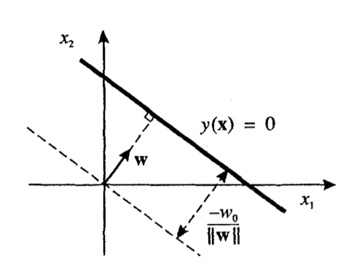
What can a perceptron compute?
Now our activation rule is:
We call y(x)=0 the decision
boundary – where the output changes from 0 to 1.
This now has a simple geometrical interpretation: y(x)=0 is a d-1 dimensional hyperplane in a d-dimensional input space
So for 2D, it is a line:

Slide 47
What can a perceptron compute?
Now our activation rule is:
Now, we call y(x)=0 the
decision boundary
– where the output changes from 0 to 1.
Why is it a line in 2D?
y(x) = 0 ➔
w₁x₁ + w₂x₂ + w₀ = 0 ➔
w₂x₂ = -w₁x₁ - w₀ ➔
x₂ = -(w₁/w₂) x₁ - w₀/w₂
x₂ = m x₁ + intercept
(in slope-intercept form)

Slide 48


What can a perceptron compute?
So for 2D, it is a line
Why is it perpendicular to w?
Take 2 points on the line y(x)=0, call them x^{A} and x^{B}. Then
And the distance l to the origin
is given by:
Notes:
Distance, l = wTx/||w||
Y(x)=0 on the line, so, 0=wTx+w_0 -> wTx=-w_0

Slide 49
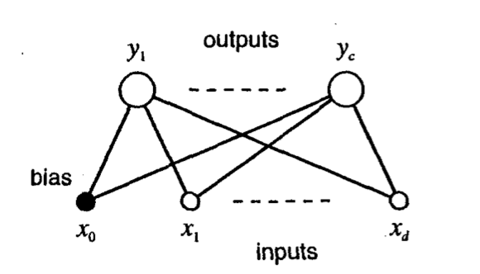
Multiple Categories
All we do is pick the largest output!
(using the net input to the neuron)

Slide 50

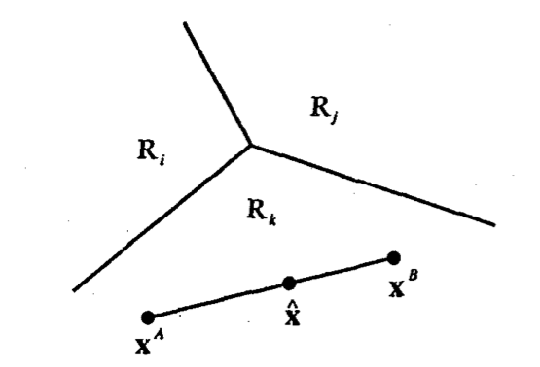

Multiple Categories
Now we make decisions as follows:
Now, the decision boundary between C_{i} and C_{j} is where
We call the part of input space that is class C_{i} Region R_{i}:

Slide 51
Multiple Categories
The decision boundary between C_{i} and C_{j} is where
What can we say
about this point?
What about this
point?
In fact, every
region is convex

Slide 52
Summary
A perceptron is a single-layer neural network
The output is 0 or 1 – it can be thought of as a classifier: if the output is 1, the input is in category 1, else it is not.
The type of categories it can discriminate are linearly separable categories.
The weight vector determines the orientation of the decision boundary, and the bias (w₀) controls where the boundary is along the weight vector.

Slide 53
Summary
Anything a perceptron can compute, it can learn to compute, using the delta rule.
Thinking of the perceptron as a linear discriminant makes the generalization to multiple categories simpler.
You can train one perceptron for each category.
Then, you can decide which category an input belongs to based on the weighted sum of the inputs:
Pick the category with the strongest evidence.

